Slide 1
CEN 3078 Computer Security
Module 5 – Cloud and IoT Security

Slide 2
Introduction to Cloud Computing
Security on Cloud Services
Cloud Storage Security
Cloud Application Security and Access Control
Introduction to Internet of Things
IoT Security and Cloud
Module 5 – Cloud and IoT Security

Slide 3
Introduction to Cloud Computing
Security on Cloud Services
Cloud Storage Security
Cloud Application Security and Access Control
Introduction to Internet of Things
IoT Security and Cloud
Module 5 – Cloud and IoT Security

Slide 4
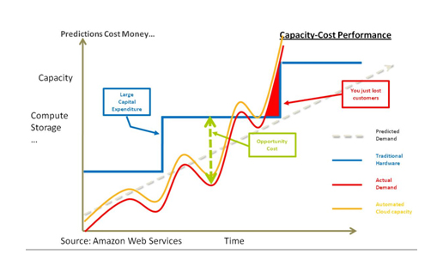
The Story of Amazon EC2
Amazon wanted to utilize their resources more efficiently
So that developers wouldn't need to procure hardware
Cloud means they didn't need to provision dedicated resource capacity for each type of system
They just needed to pull from the resource pool
Still, there was a need for sufficient peak capacity (such as during holidays), so a large amount of hardware wasn't in use every day.
Renting out spare capacity (EC2)
The public AWS is a separate project, not leasing core capabilities, but all of Amazon's business runs on top of it
Notes:
Telling the story of the Amazon’s entrance into the cloud computing business is an interesting way to begin the day, to provide real context for how cloud computing works and show the evolution of Amazon’s experience.
At it’s core, it’s an efficiency play. Amazon needed to make better use of their resources, since they had to provision enough resources for Black Friday (the biggest shopping day of the year in the US), which wasn’t used particularly effectively the rest of the year. They also wanted their developers to get things done, as opposed to fight with IT about provisioning resources. Amazon’s flavor of cloud allowed resources to be pulled from their core computing pool in a self-service model. Remember that fact, as self-service becomes important later in the module.
Finally Amazon figured they could leverage these technologies to provide a public platform and build a profitable business. As of early 2015, AWS was a $5B business, with over $260M in profits.

Slide 5

Resource Pools
Storage Resources
Network Resources
Computing Resources
Notes:
The concept of resource pools is a critical aspect of cloud computing. The idea is that a service provider (or multiple service providers) will have many distinct resources available for compute (CPU), networks, and storage. These may be in one data center, or many. It could be in one geographic area, or many. To the customer, the location of any of the resources isn’t important. The customer only wants to be able to get access to the computing resources they need (compute, networking, storage) to make it all work together.
Thus they mix and match resources that exist within these resource pools to deliver what they need to meet the applications demands. And the idea is these allocations are fungible and will change over time.

Slide 6
What is Cloud Computing?
Applications and commodity computing resources (storage, CPU, networking, etc.) are separated in the cloud model. So the idea of managing actually servers and provisioning storage and dealing with network connectivity is no longer an issue.
Another aspect of cloud computing is flexibility, since computing resources are organized into “pools” this allows customers to buy what they need. However they want to buy it.
These so-called pools can be instantly provisioned and rolled-out (or deprovisioned and taken offline) meaning there aren’t constraints to how quickly the infrastructure can be changed.
Cloud resources can be scaled up and/or down with ease, providing a customer the ability to scale their environment based on usage, not based on hardware.
Notes:
One of the biggest challenges of security cloud computing is to just understand what cloud computing is. Here are four aspects of the cloud that should clarify things a bit.
Applications and commodity computing resources (storage, CPU, networking, etc.) are separated in the cloud model. So the idea of managing actually servers and provisioning storage and dealing with network connectivity is no longer an issue.
Another aspect of cloud computing is flexibility, since computing resources are organized into “pools” this allows customers to buy what they need. However they want to buy it.
These so-called pools can be instantly provisioned and rolled-out (or deprovisioned and taken offline) meaning there aren’t constraints to how quickly the infrastructure can be changed.
Cloud resources can be scaled up and/or down with ease, providing a customer the ability to scale their environment based on usage, not based on hardware.

Slide 7
Potential benefits
Of Cloud Computing
Agility Resiliency Economics
No Capital Expenditures
More Agility
Unbounded Scale
Improved Resource Utilization
Customer-controlled Migration
Resilience
Pay for Use
Notes:
The main potential benefits are better agility, resiliency, and economics. But only if you adapt your architectures to match the requirements of the cloud. Otherwise you will be less agile, less resilient, and it will cost more.
The benefits of cloud computing are still being defined, but here are a few areas where embracing the cloud can definitely have an impact on IT operations.
No Capital Expenditures – Cloud computing removes the need for a company to invest in a physical data center. It’s the providers problem to build (and manage) the facility, provision power, network connectivity, and the like. The customer just pays a monthly charge for what they use.
More Agility – Without having to deal with physically implementing hardware, customers can roll out new applications and/or scale existing environments instantly. Provisioning hardware infrastructure ceases to be an impediment to rolling out new technology capabilities.
Unbounded Scale – Cloud providers don’t run out of space in the racks. They don’t have power constraints. They don’t need to wait for their storage vendor to send another array. Or maybe they do, but that’s not the customer’s problem anymore. The customer expect to and can scale their environment to whatever degree they need to (and can afford).
Improved Resource Utilization – Since all infrastructure (compute, networks, storage, etc.) are shared amongst all customers, this provides a better utilization of hardware resources. Again, the customer isn’t worried about that (since they get what they want when they want it), but it allows the provider to deliver a service at a lower cost, since they are using their resources more efficiently.
Customer-controlled Migration – Customers can use the cloud to whatever degree makes sense for their application. They can build (or move) the entire environment in the cloud, they can use the cloud for capacity at peak usage times, or they can use the cloud to add more locations or additional resources to supplement internal resources. The architecture of a cloud provider allows the customer to figure out what makes sense for them at any given time, without locking them into a specific division of computing resources.
Resilience – Cloud environments are architected to eliminate single points of failure and are built specifically with resilience in mind. Do cloud providers go down? Yes. But given the number of other customers using the resources, the provider is going to move to restore service with urgency. The data centers are monitored 24/7 and each device is managed with sophisticated software to ensure maximum uptime.
Pay for Use – If a customer needs another server, you launch another instance and pay for it. If you need to provision a separate network segment, you do that also and pay for it. If you need another TB of storage to scale an application, you can provision that and add the volume where it’s needed. And you pay for that. But you don’t pay for what you don’t need, and what you don’t use.

Slide 8
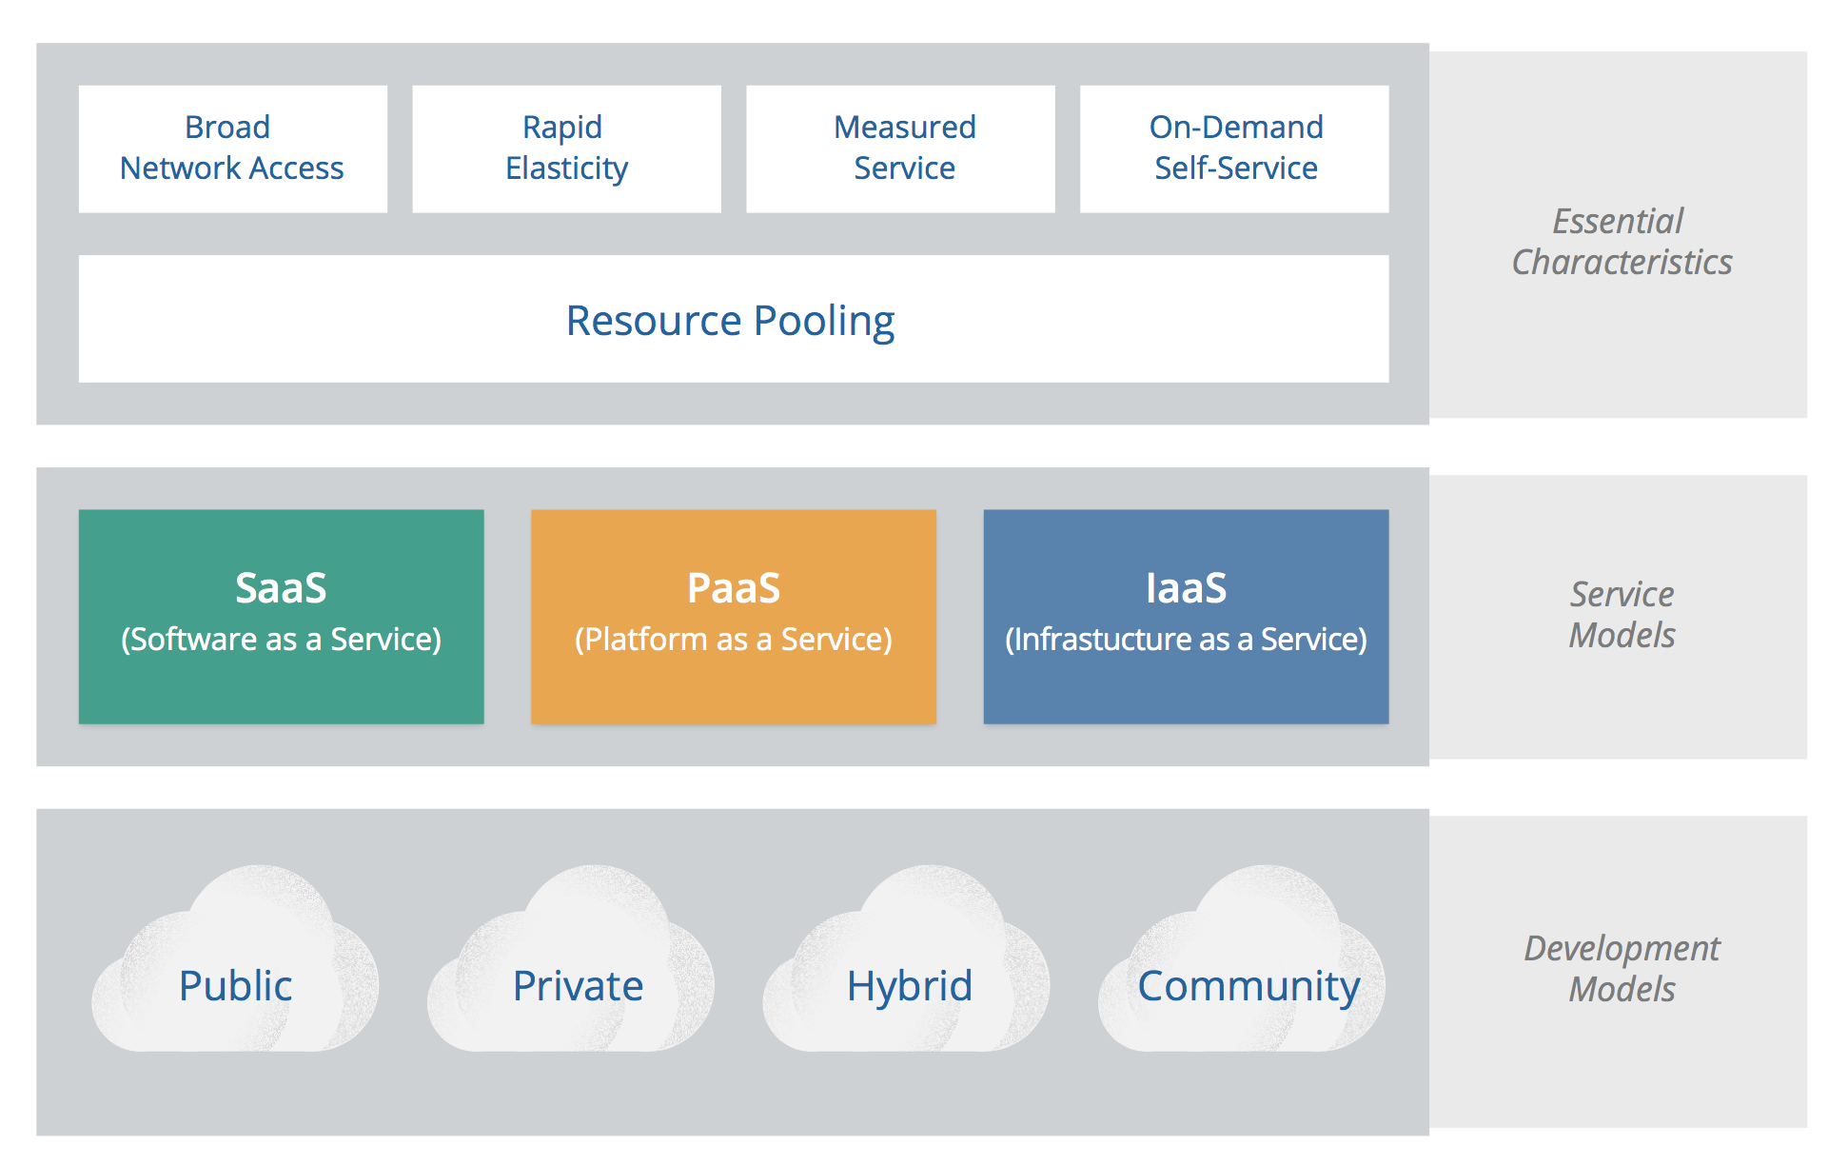
NIST Cloud Computing Model
Notes:
NIST’s publication is generally well accepted, and the CSA has chosen to align with the NIST Working Definition of cloud computing (version 15 as of this writing) to bring coherence and consensus around a common language so we can focus on use cases rather than semantic nuance. It is important to note that this guide is intended to be broadly usable and applicable to organizations globally. While NIST is a U.S. government organization, the selection of this reference model should not be interpreted to suggest the exclusion of other points of view or geographies. NIST defines cloud computing by describing five essential characteristics, three cloud service models, and four cloud deployment models. They are summarized in visual form in figure 1 and explained throughout the rest of this module.

Slide 9
Resource Pooling
Rapid Elasticity
Broad Network Access
Standard clients, like mobile phones, laptops and desktop computers
Traditional software services
There shouldn’t be any restrictions in terms of access via cloud-based software services either.
Measured Service
On-Demand Self-Service
Essential Characteristics
Notes:
The first of the essential characteristics is “Broad Network Access,” which basically means the computing resources are available through pretty much any mechanism desired. These may include:
Standard clients, like mobile phones, laptops and desktop computers, both internal and external to your corporate network.
Traditional software services, like applications and middleware. Since the cloud provides similar capabilities to what a company would build themselves, any cloud-resident resources would need to be accessible from computing resources (both internal and external) to the organization.
There shouldn’t be any restrictions in terms of access via cloud-based software services either.

Slide 10
Broad Network Access
Resource Pooling
Measured Service
Rapid Elasticity
To the customer, the capabilities available for provisioning often appear to be unlimited
Can be purchased in any quantity at any time. This applies to both scaling and contracting the infrastructure at any time.
On-Demand Self-Service
Essential Characteristics
Notes:
To the customer, the capabilities available for provisioning often appear to be unlimited and can be purchased in any quantity at any time. This applies to both scaling and contracting the infrastructure at any time.

Slide 11
Resource Pooling
Broad Network Access
Measured Service
Automated control and optimization of resource usage
Leveraging some level of abstraction in measurement capability
Utility computing - paying only for the portion you use
On-Demand Self-Service
Rapid Elasticity
Essential Characteristics
Notes:
Resource usage can be monitored, controlled, and reported — providing transparency for both the provider and consumer of the service. Any abstraction from a measurement standpoint needs to be appropriate to the type of service (e.g., storage, processing, bandwidth, or active user accounts).

Slide 12
Broad Network Access
Resource Pooling
On-Demand Self-Service
Rapid Elasticity
Users can automatically provision computing capabilities such as server time and network storage as needed, without the need for manual interaction with the provider.
Measured Service
Essential Characteristics

Slide 13
Broad Network Access
Resource Pooling
Resources are pooled and provided to multiple clients in a multi-tenant model.
Different physical and virtual resources are used.
Location independence Customers cannot control the exact location of resources.
Rapid Elasticity
On-Demand Self-Service
Measured Service
Essential Characteristics

Slide 14
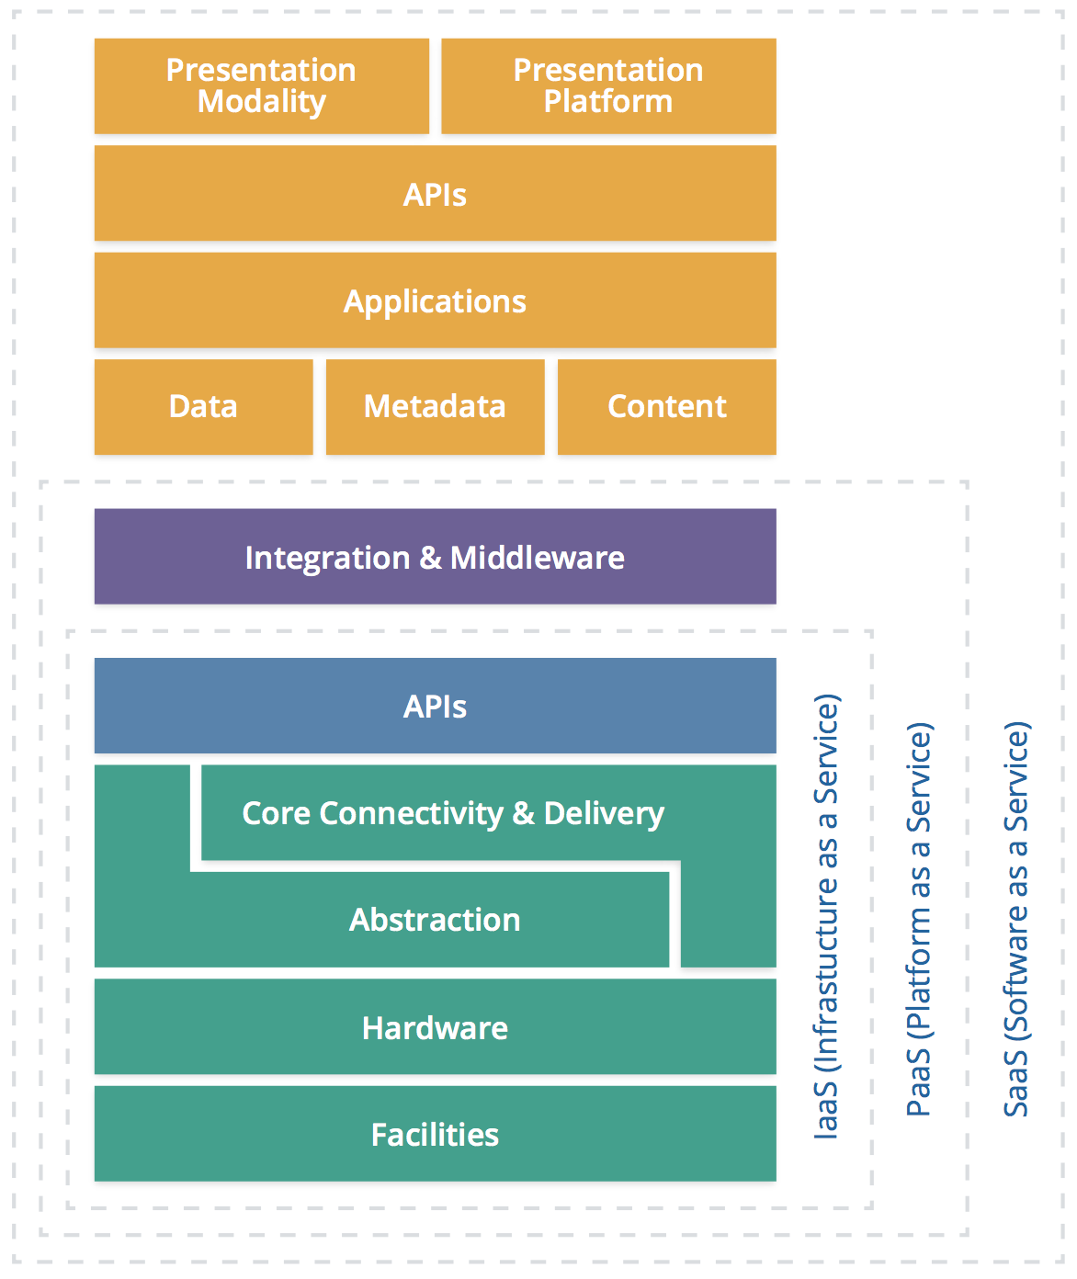
Cloud Service
The SPI stack.
S for Software as a Service.
P for Platform as a Service.
I for Infrastructure as a Service.
Notes:
In terms of what you buy when you look at cloud services, the types of offerings tend to broken up into three different levels. We’ll go through each distinction in some detail.
These offerings tend to be describe as the SPI stack. S for Software as a Service. P for Platform as a Service. And I for Infrastructure as a Service. Now the cloud stack is clearly evolving and we are seeing a lot of overlap and less clear distinction between the layers of the stack. So first, let’s get a feel for the standard definitions of each layer in the stack and then we can use some examples to show the blurring that is happening now.

Slide 15
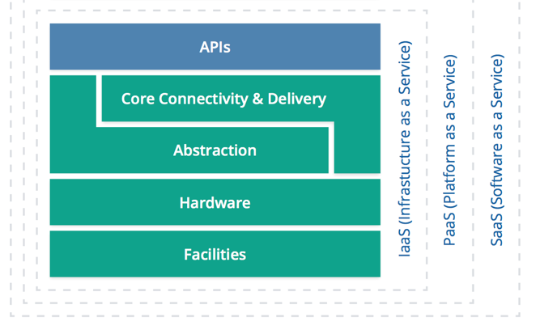
Infrastructure as a Service(IaaS)
The customer then can install its own software or interact with the computing infrastructure via a set of abstractions and/or APIs.
The consumer does not manage or control the underlying cloud infrastructure but has control over operating systems, storage, deployed applications, and possibly limited control of select networking components (e.g., host firewalls).
Notes:
IaaS is likened to running your own data center, but without having to worry about the details. The provider offers:
Facilities
Hardware
The customer then can install its own software or interact with the computing infrastructure via a set of abstractions and/or APIs. So for example, the provider will access to the virtual “server” that happens to reside within the providers infrastructure.
The consumer does not manage or control the underlying cloud infrastructure but has control over operating systems, storage, deployed applications, and possibly limited control of select networking components (e.g., host firewalls).

Slide 16
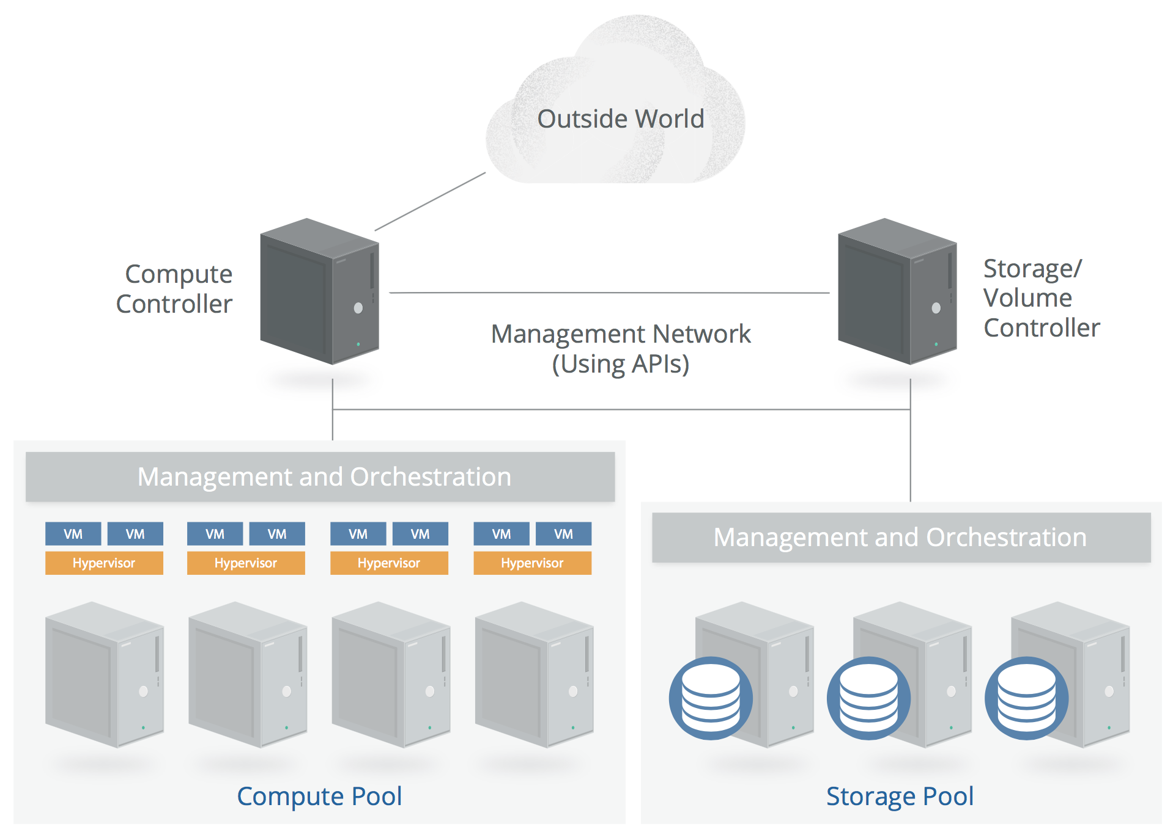
Simplified IaaS Architecture

Slide 17
Platform as a Service(PaaS)
Application development frameworks, middleware capabilities, as well as functionalities like databases, messaging, queues, etc.
Deploying services created or acquired by users to cloud infrastructure
Creating applications using programming languages and tools supported by cloud providers
Notes:
PaaS is the next level up, further abstracting the hardware by providing access via middleware or other integrations offered by the provider.
To be clear:
The consumer does not manage or control the underlying cloud infrastructure including network, servers, operating systems, or storage.
The consumer has control over the deployed applications and possibly application hosting environment configurations, but none of the configurations of the underlying infrastructure.

Slide 18
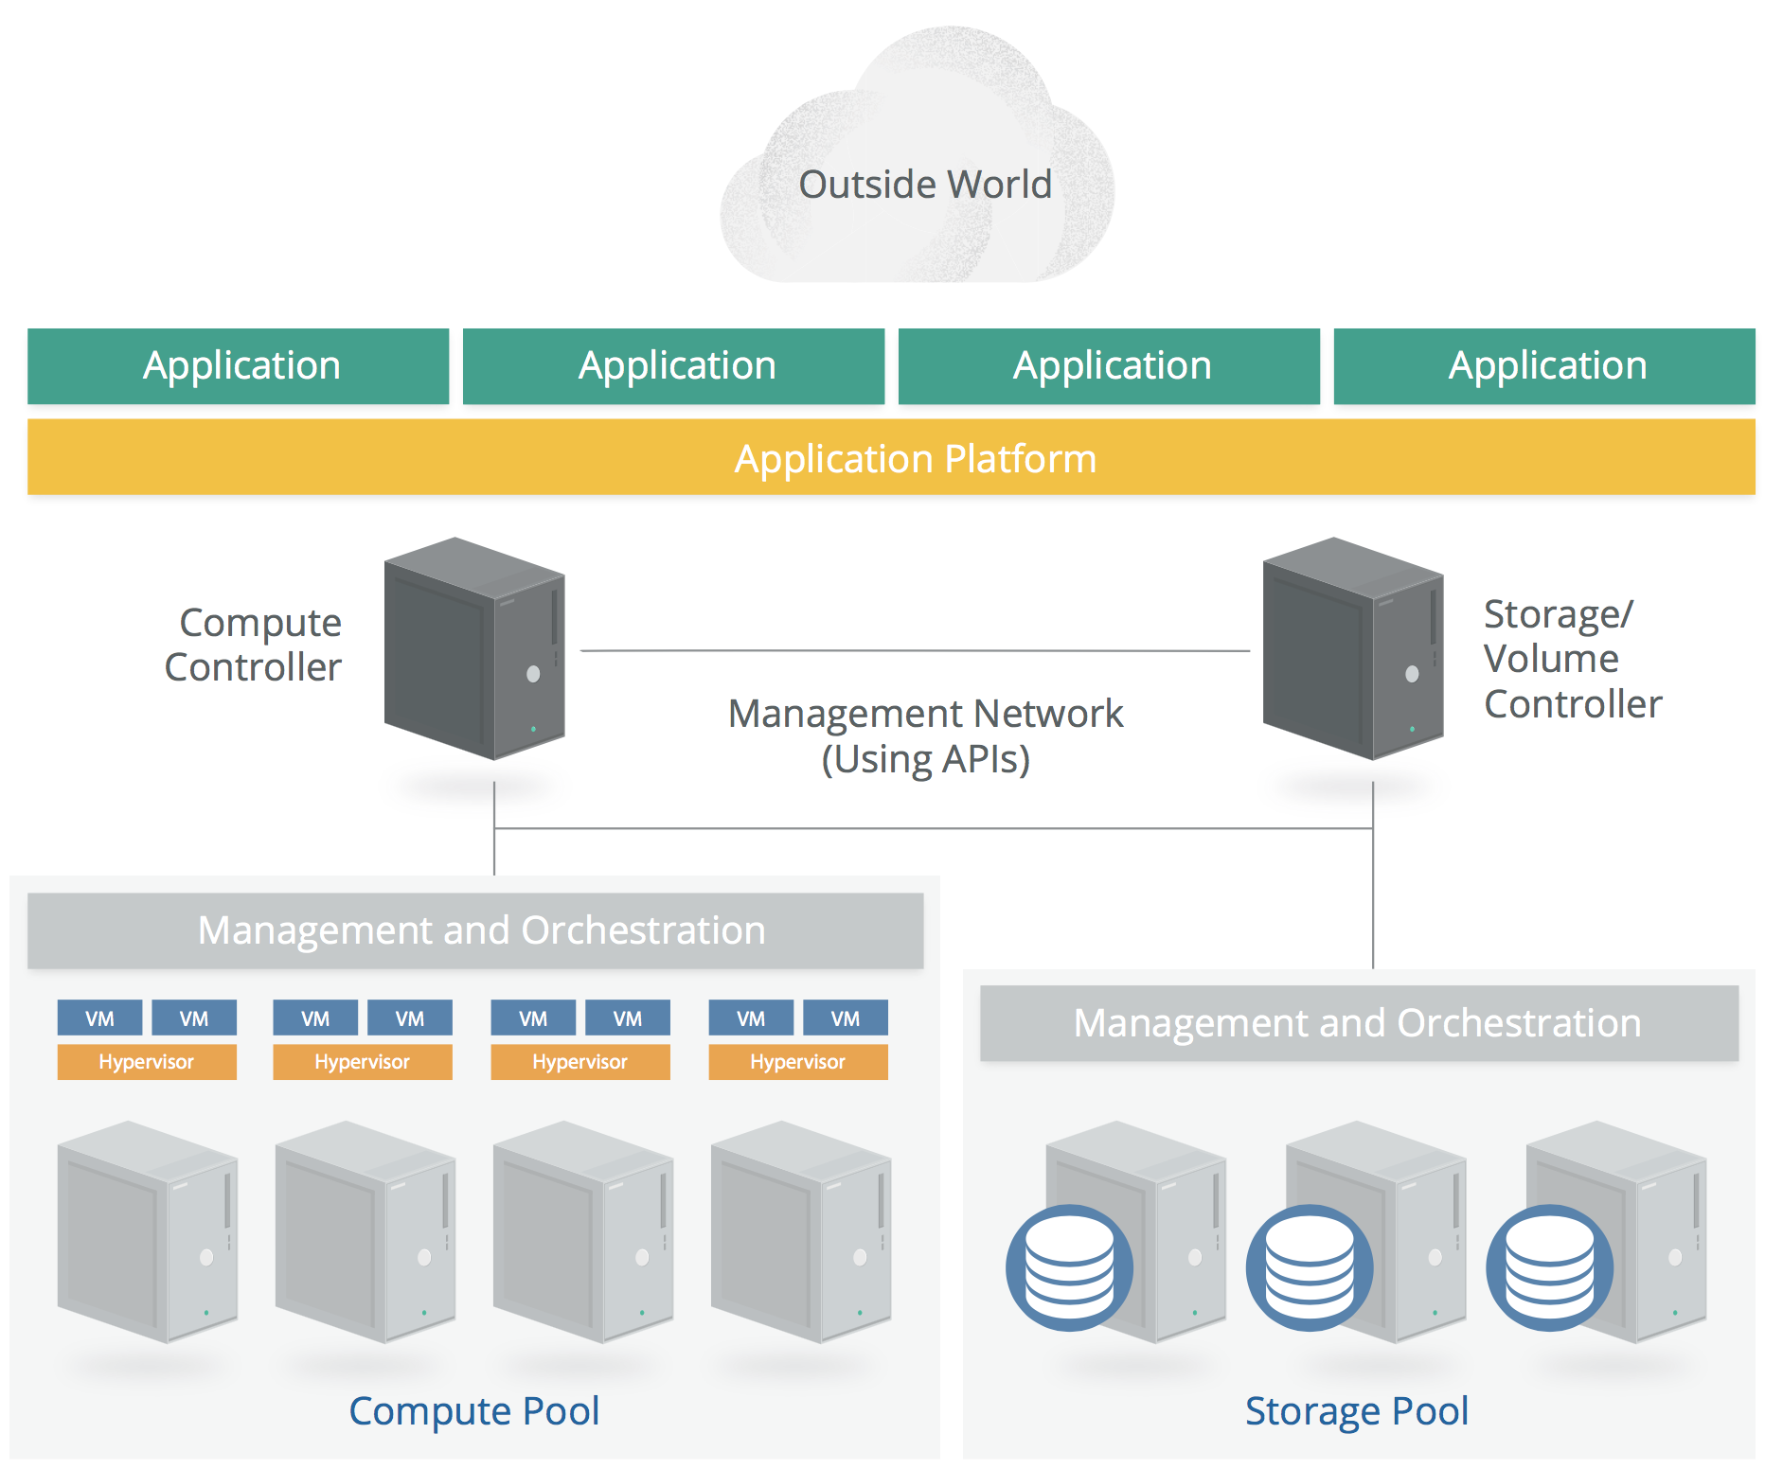
Simplified PaaS Architecture

Slide 19

Software as a Service(SaaS)
Users utilize applications provided by service providers.
SaaS doesn't necessarily have to run on IaaS or PaaS, but still needs to have basic cloud characteristics.
Users cannot manage or control the underlying infrastructure including networks, servers, operating systems, storage, or even individual application capabilities.
Notes:
The applications are accessible from various client devices through a thin client interface such as a web browser (e.g., web-based email).
Consumers may have limited user-specific application configuration settings, as well as limited ability to customize the application.
Examples of prominent SaaS applications include:
Salesforce.com
Gmail
Quickbooks Online
MailChimp (email list management)
Marketo (marketing automation)
Workday (HR and accounting)

Slide 20
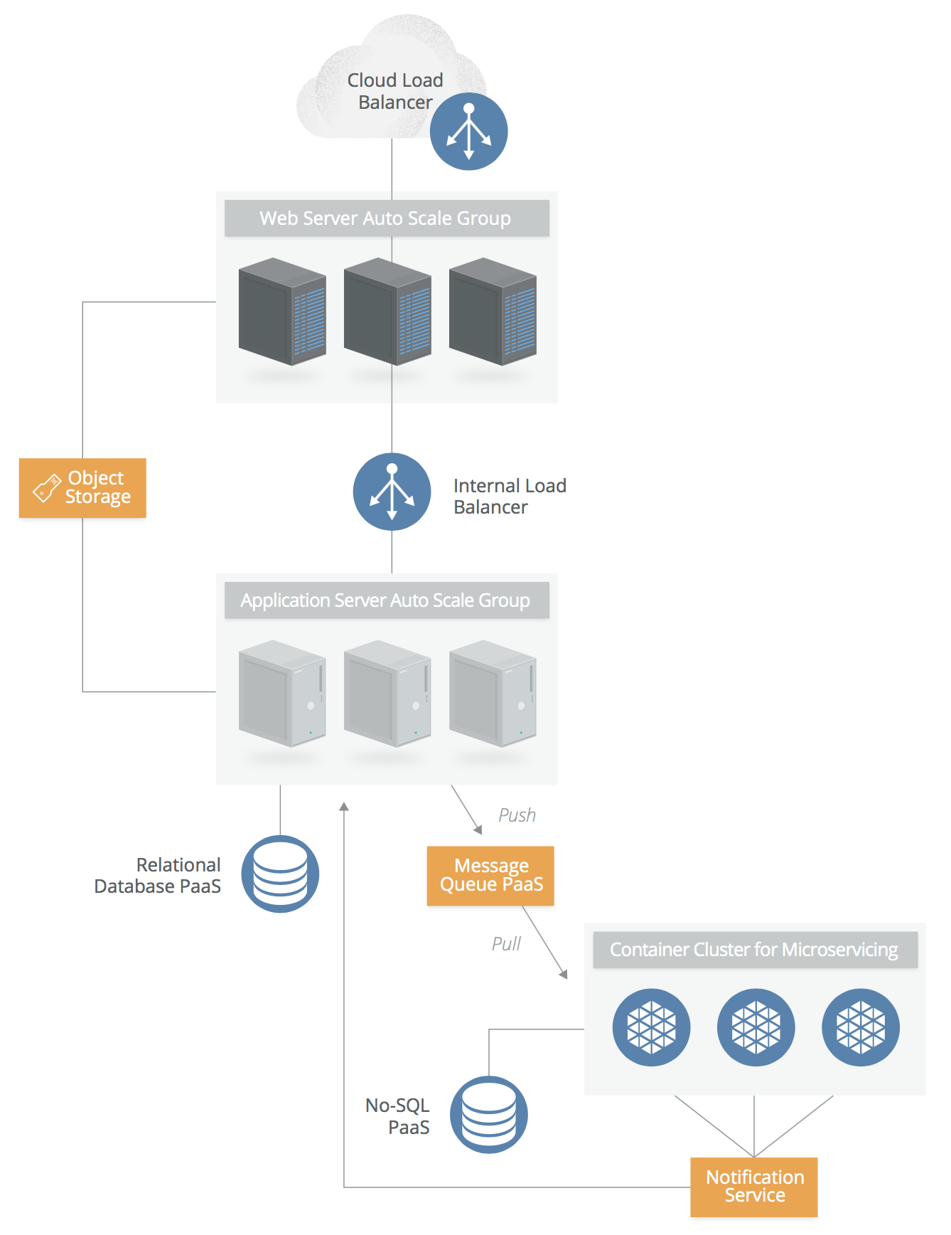
Simplified SaaS Architecture
Notes:
This architecture will be discussed in detail in the next module.

Slide 21
Introduction to Cloud Computing
Security on Cloud Services
Cloud Storage Security
Cloud Application Security and Access Control
Introduction to Internet of Things
IoT Security and Cloud
Module 5 – Cloud and IoT Security

Slide 22
macro layers
Management plane
Virtual infrastructure
Fundamental resources
Notes:
In cloud computing, there are two macro layers to infrastructure, plus the management plane that ties them together:
• The fundamental resources pooled together to create a cloud. This is the raw, physical and logical compute (processors, memory, etc.), networks, and storage used to build the cloud’s resource pools. For example, this includes the security of the networking hardware and software used to create the network resource pool.
• The virtual/abstracted infrastructure managed by a cloud consumer. That’s the compute, network, and storage assets that they use from the resource pools. For example, the security of the virtual network, as de ned and managed by the cloud consumer.
The information and advice in this domain primarily focuses on the second macro layer, infrastructure security for the cloud consumer. Infrastructure security that’s more fundamental for cloud providers, including those who manage private clouds, is well aligned with existing security standards for data centers.

Slide 23
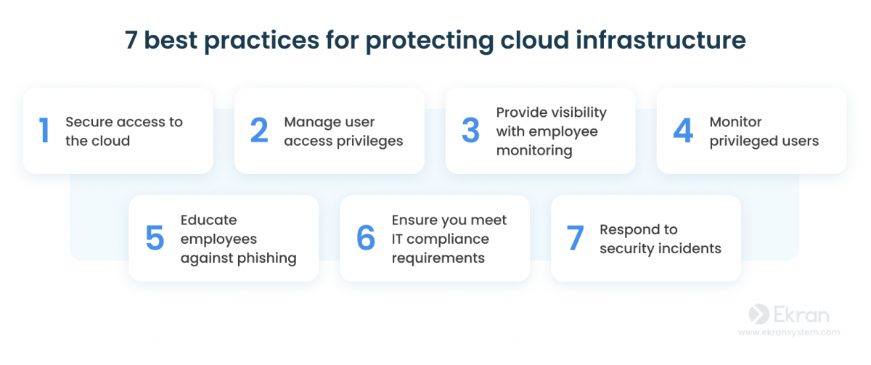

Slide 24
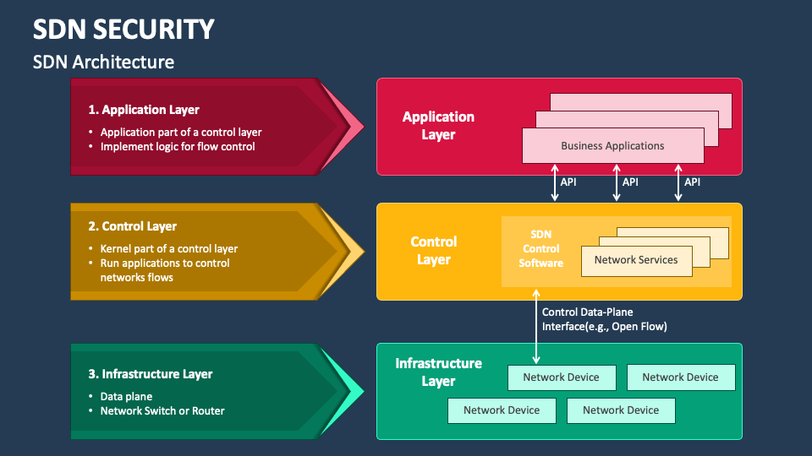

Slide 25
macro layers
Security Suggestions
Management plane
Virtual infrastructure
Fundamental resources
Notes:
In cloud computing, there are two macro layers to infrastructure, plus the management plane that ties them together:
• The fundamental resources pooled together to create a cloud. This is the raw, physical and logical compute (processors, memory, etc.), networks, and storage used to build the cloud’s resource pools. For example, this includes the security of the networking hardware and software used to create the network resource pool.
• The virtual/abstracted infrastructure managed by a cloud consumer. That’s the compute, network, and storage assets that they use from the resource pools. For example, the security of the virtual network, as de ned and managed by the cloud consumer.
The information and advice in this domain primarily focuses on the second macro layer, infrastructure security for the cloud consumer. Infrastructure security that’s more fundamental for cloud providers, including those who manage private clouds, is well aligned with existing security standards for data centers.

Slide 26
Suggestions on Virtual Infrastructure
It's preferable to use SDN if available.
Utilize SDN functionality for multiple virtual networks and multiple cloud accounts/segments to enhance network isolation.
Independent accounts and virtual networks greatly limit the scope of harm compared to traditional data centers.
Implement default deny on cloud firewalls.
Base cloud firewall policies on each workload rather than per network application.
Use cloud firewall policies to restrict communication between workloads within the same virtual subnet as much as possible, such as using security groups.
Notes:
This is a summary of what we’ve talked about. It comes down to understanding how you can monitor and filter traffic on your cloud platform, and picking the right layers to focus your efforts. This varies quite a bit based on the cloud platform- with some offering robust connections for different network security tools, and others offering absolutely nothing.
Watch out for virtual appliances as a complete replacement for physical appliances. While they work, they will likely run into performance issues with any significant volume of traffic on the virtual network. On the other hand, injecting a physical appliance may create its own performance issues. This is a rapidly evolving area and one that’s beyond the scope of this class to fully delve into.

Slide 27

Suggestions on Fundamental Resources
Maintain security controls for long-running workloads using tools that can identify the cloud environment.
Disable remote access.
Integrate security testing into the image creation process.
Set up alerts and file integrity monitoring.
Patch by updating images rather than directly patching running instances.
Select security agents that are cloud-aware and minimize performance impact.
Store logs externally from the workload.
Understand and comply with the cloud provider's limitations on vulnerability assessments and penetration testing.

Slide 28
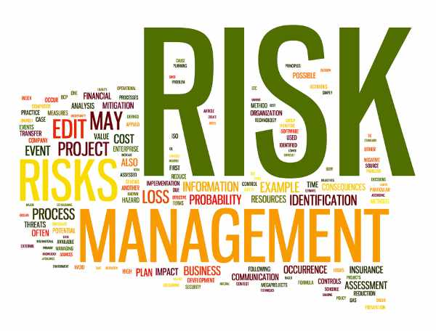
Suggestions on Management Plane
Ensure that API gateways and web consoles have sufficient perimeter security.
Utilize strong authentication and multi-factor authentication.
Strictly control the credentials of the main account holder/root account and consider dual authorization access to them.
Establishing multiple accounts with your provider will help with account granularity and limit the scope of harm (using IaaS and PaaS).

Slide 29
Introduction to Cloud Computing
Security on Cloud Services
Cloud Storage Security
Cloud Application Security and Access Control
Introduction to Internet of Things
IoT Security and Cloud
Module 5 – Cloud and IoT Security

Slide 30
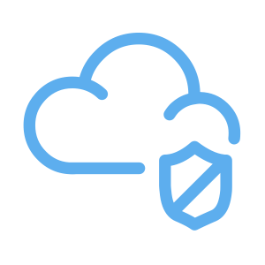
Why Cloud Storage
All data ultimately needs to be stored on physical devices, but cloud platforms abstract and build storage pools through various types of data storage virtualization.
This type of storage can present the same functionality as traditional storage, but underneath the surface, it's completely different technology.
Just like SDN, the focus of security concerns is on access control, encryption, and proper configuration.

Slide 31
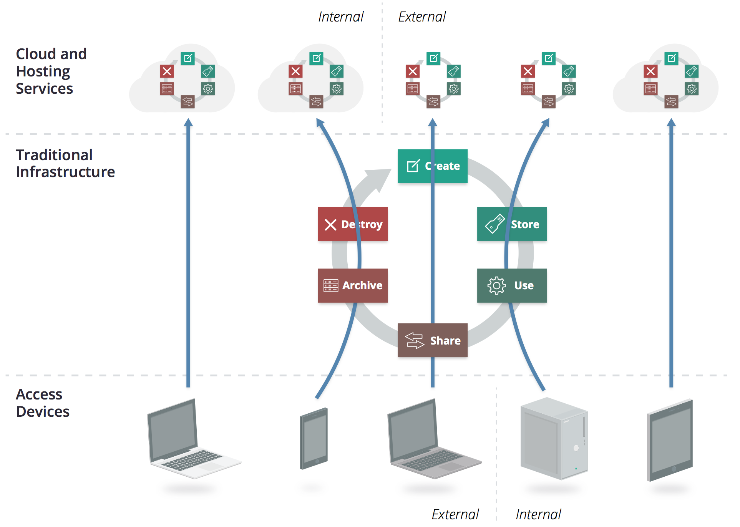
Access and Location
Notes:
Point here is you won’t treat a web or mobile apps the same as internal apps, and data can move between different clouds/environments at different points of the cycle.
And your mobile and web apps will have different controls to enforce policy.
When you look at it in this way you see that it’s not a single data security lifecycle, but many smaller ones for each combination of location. The key is to

Slide 32
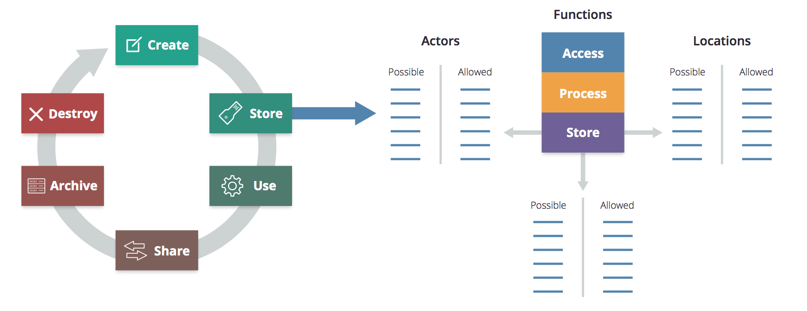
Map Life Cycle to Matrix
Notes:
Now let’s take the storage phase from the previous slide and map that to the matrix – Certain users will be able to access and store data from specific locations.
Think about how users may access data in a hybrid cloud from inside your company, across a VPN, or from their mobile phone?
What will you allow? What will you deny?
Similarly, for each phase of the lifecycle we need to map allowable actors and locations. This is a slightly labor intensive approach but in essence this is what we do today with mobile and browser based apps.
From there we map out controls based upon users and locations.

Slide 33
Cloud Storage Security - Suggestions
Understand the unique capabilities of the cloud platform you are using.
Don't overlook data security from the cloud provider. In many cases, it's more secure and cost-effective than self-building.
Create an authorization matrix for access control decisions. There are significant differences in execution capabilities based on the cloud provider's abilities.
Select appropriate encryption options based on threat models tailored to data, business, and technical requirements.

Slide 34
Cloud Storage Security – Suggestions – Cont.
Consider using provider-managed encryption and storage options. Use user-managed keys where possible.
Leverage architecture to enhance data security. Don't rely solely on access control and encryption.
Ensure that API and data-level monitoring are properly implemented, and logs meet compliance and lifecycle policy requirements.

Slide 35
Introduction to Cloud Computing
Security on Cloud Services
Cloud Storage Security
Cloud Application Security and Access Control
Introduction to Internet of Things
IoT Security and Cloud
Module 5 – Cloud and IoT Security

Slide 36
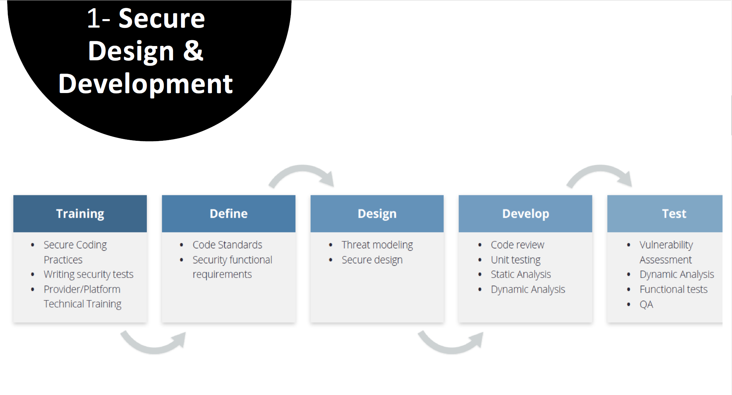

Slide 37
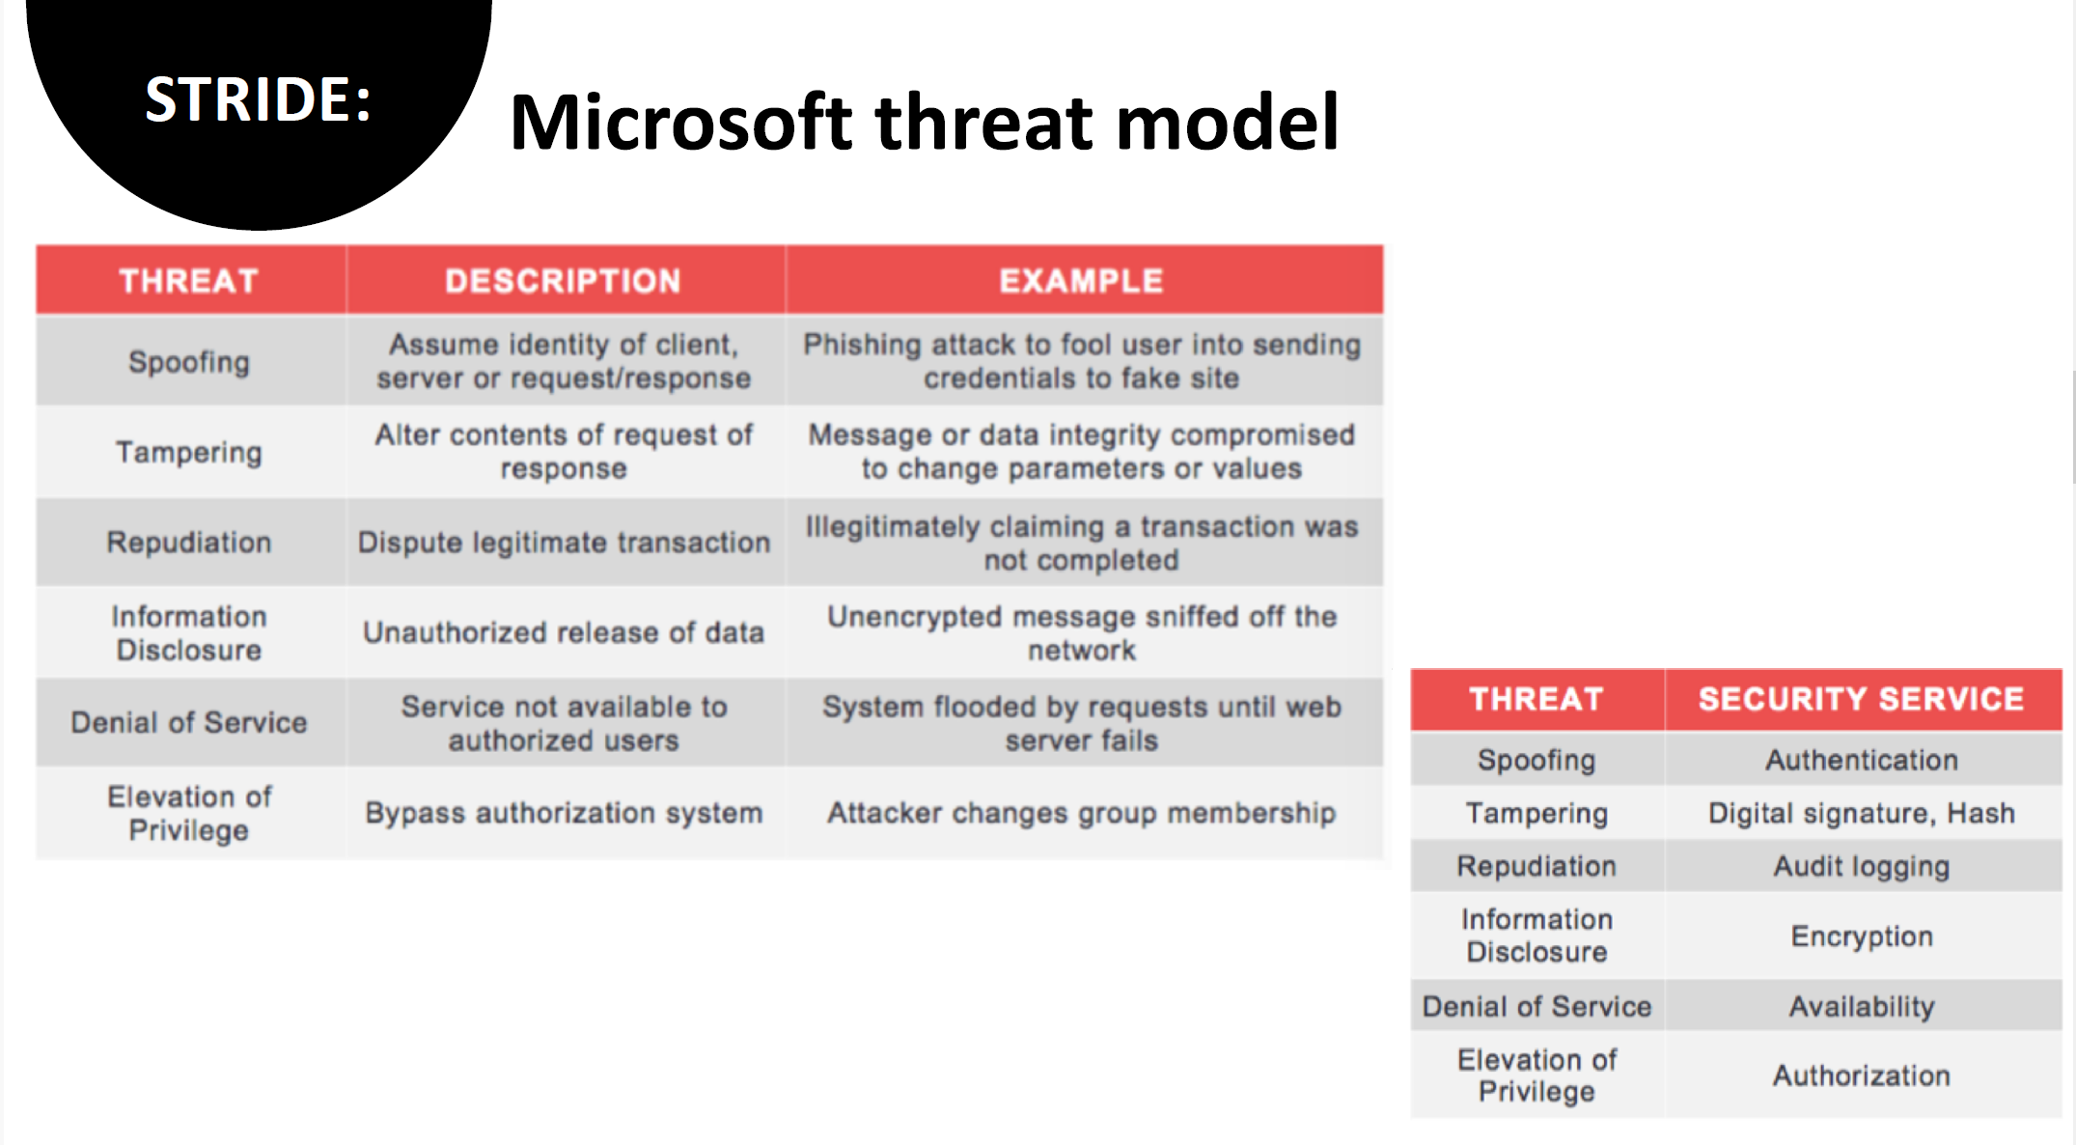

Slide 38
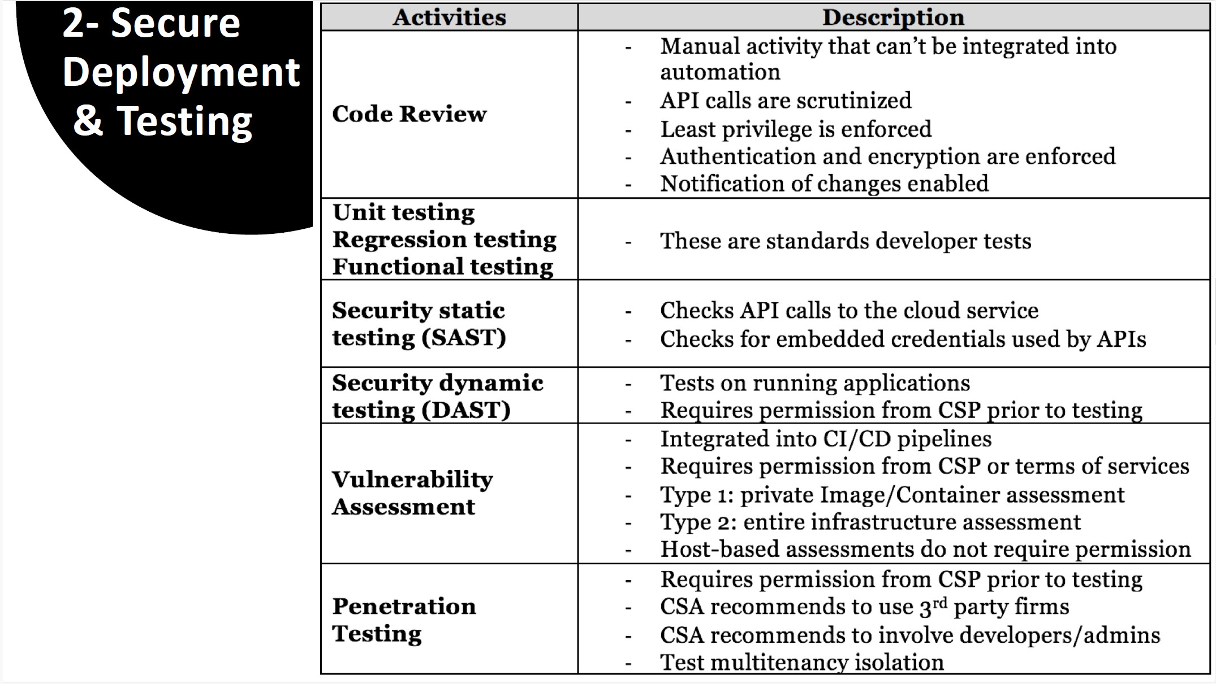

Slide 39
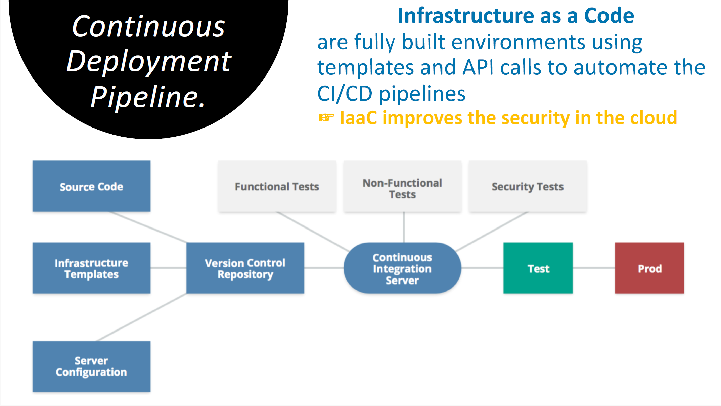

Slide 40
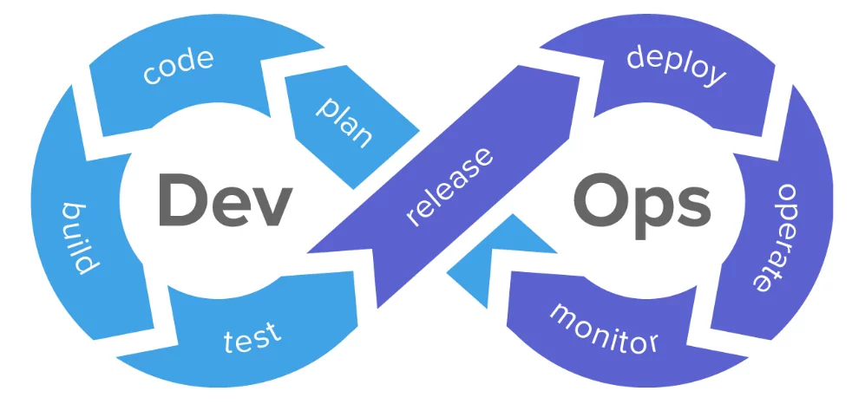
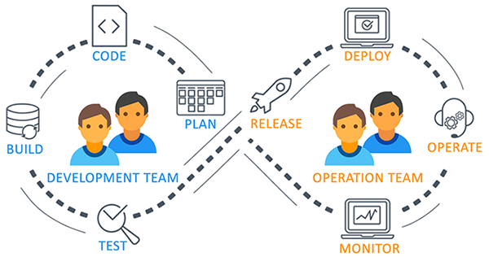
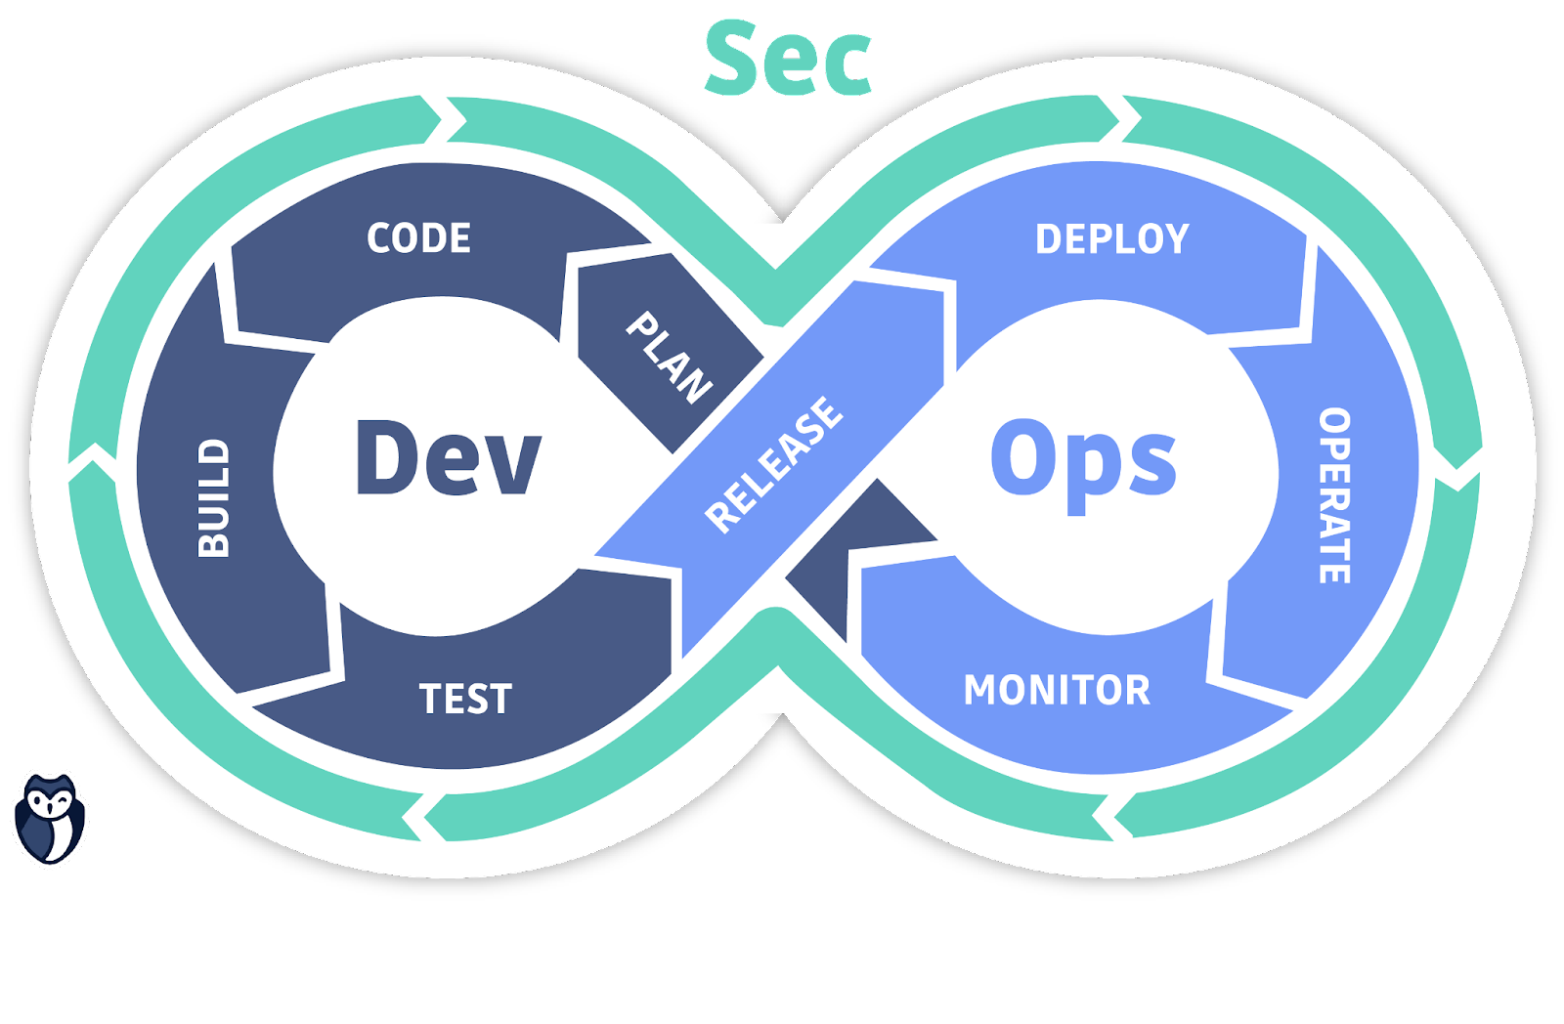

Slide 41
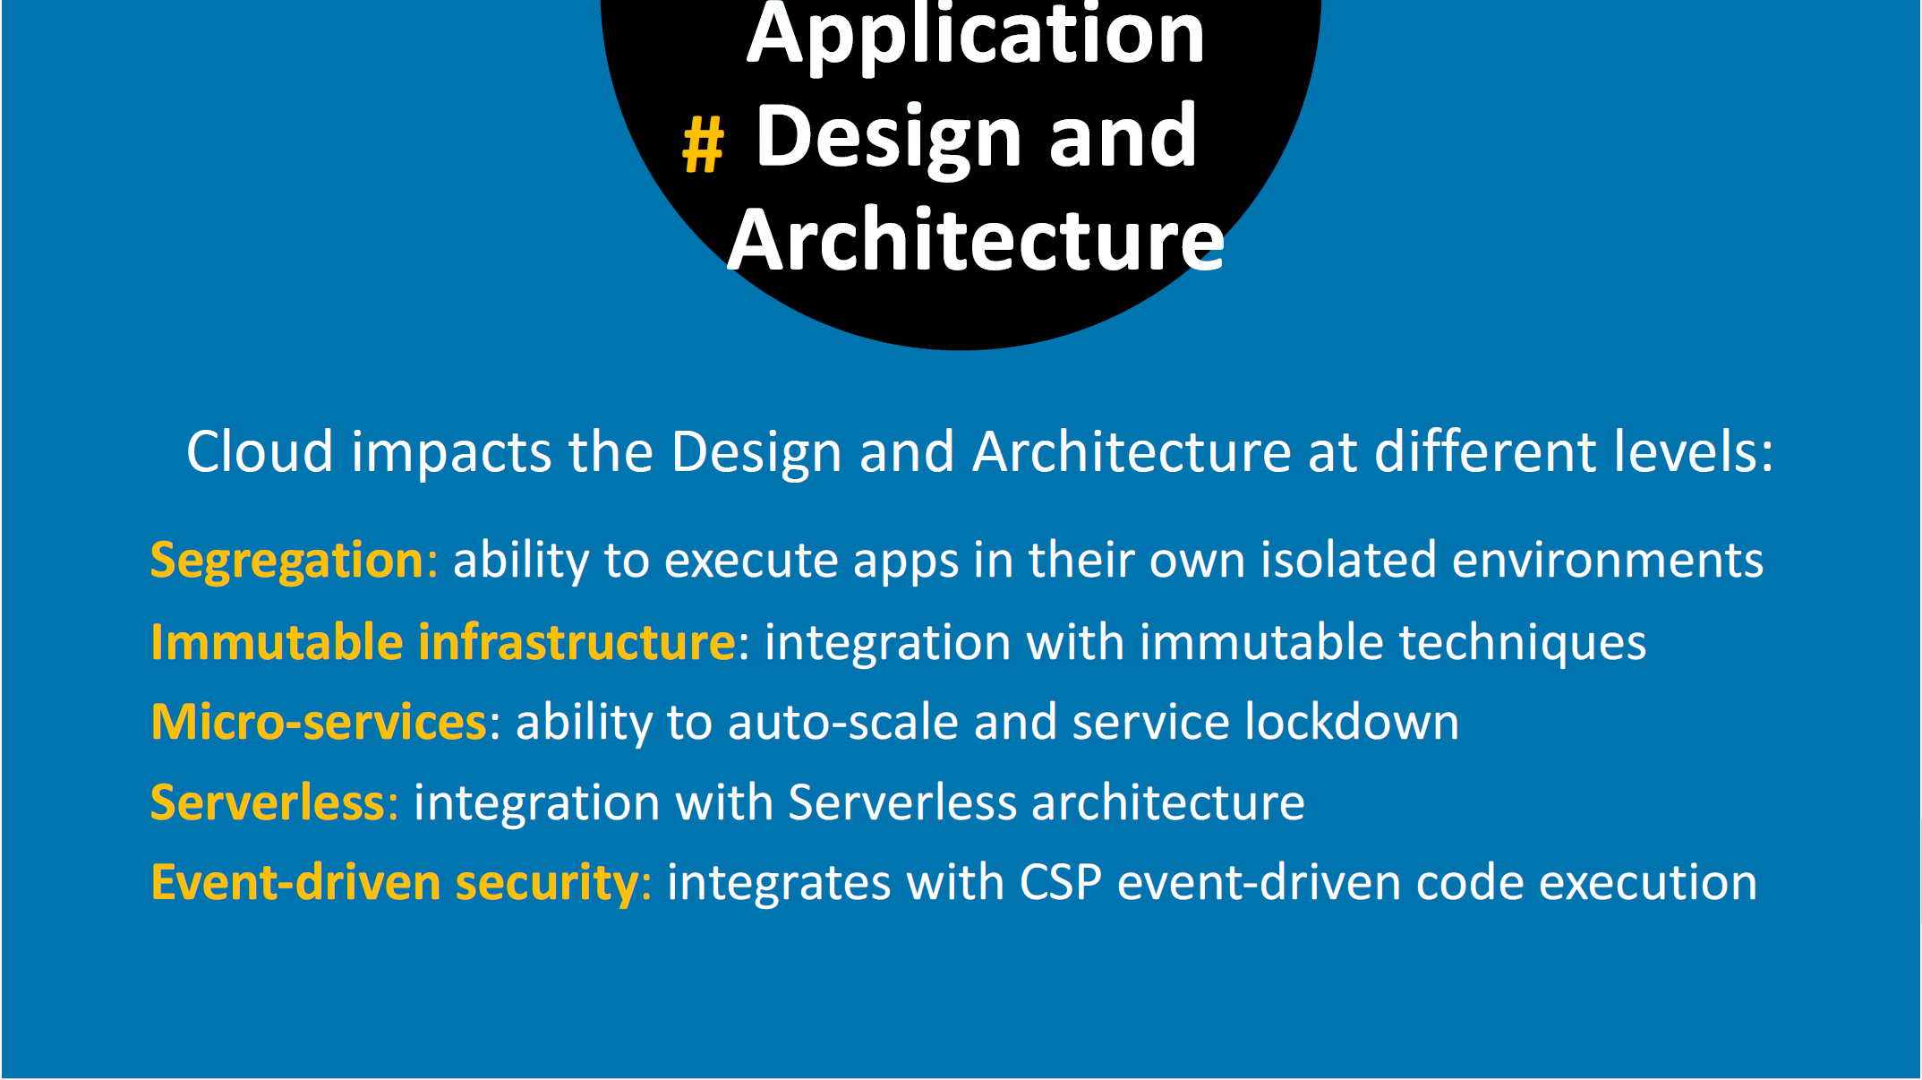

Slide 42
Introduction to Cloud Computing
Security on Cloud Services
Cloud Storage Security
Cloud Application Security and Access Control
Introduction to Internet of Things
IoT Security and Cloud
Module 5 – Cloud and IoT Security

Slide 43
Related Technologies Introduction

Slide 44
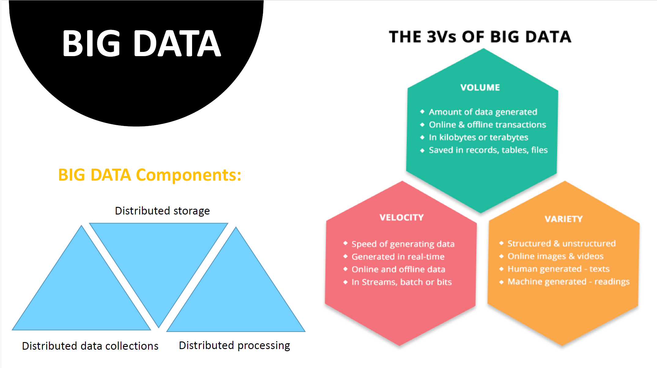

Slide 45
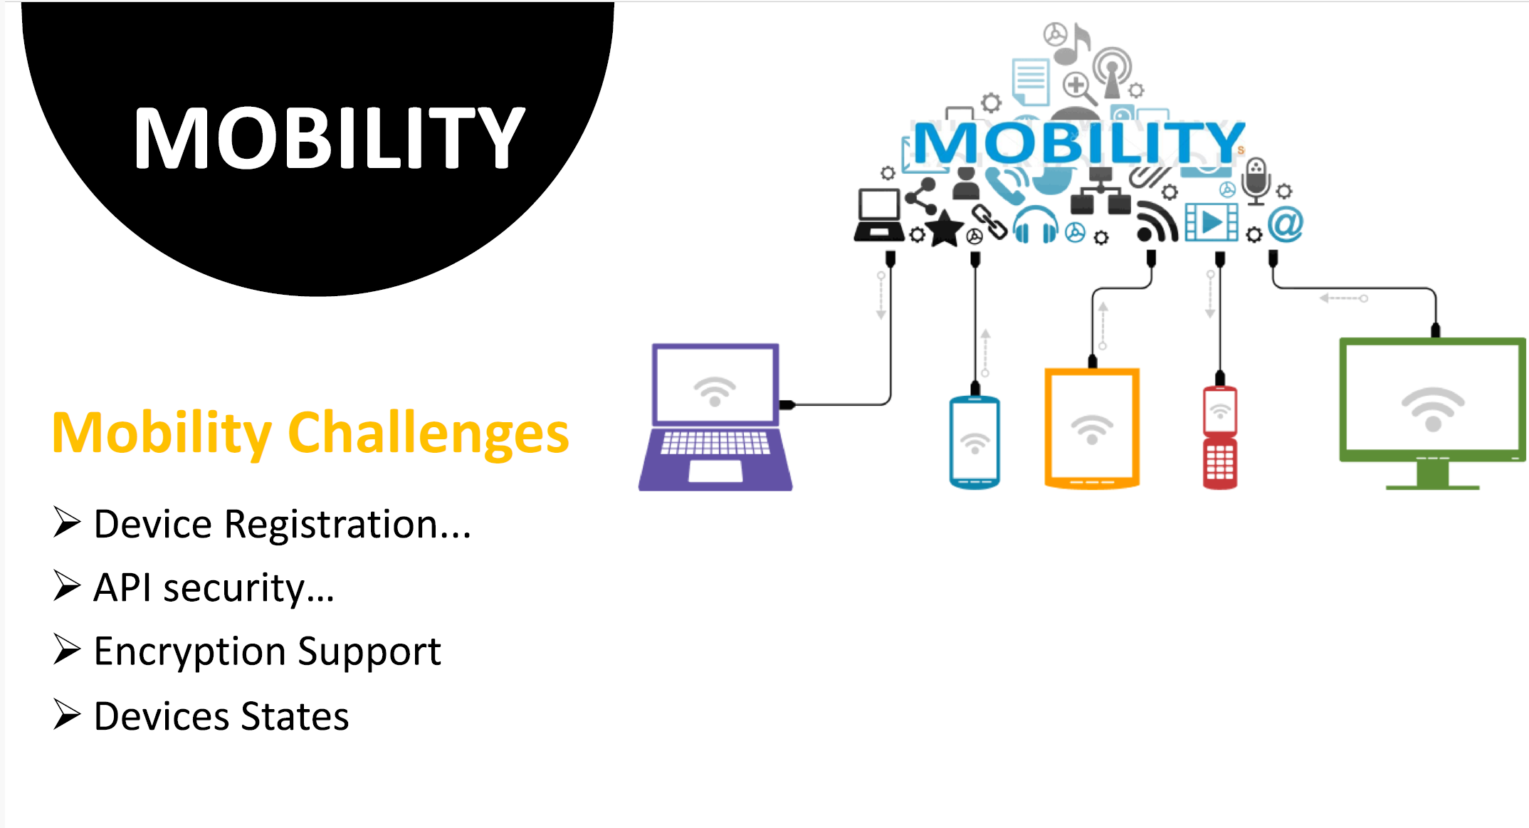

Slide 46
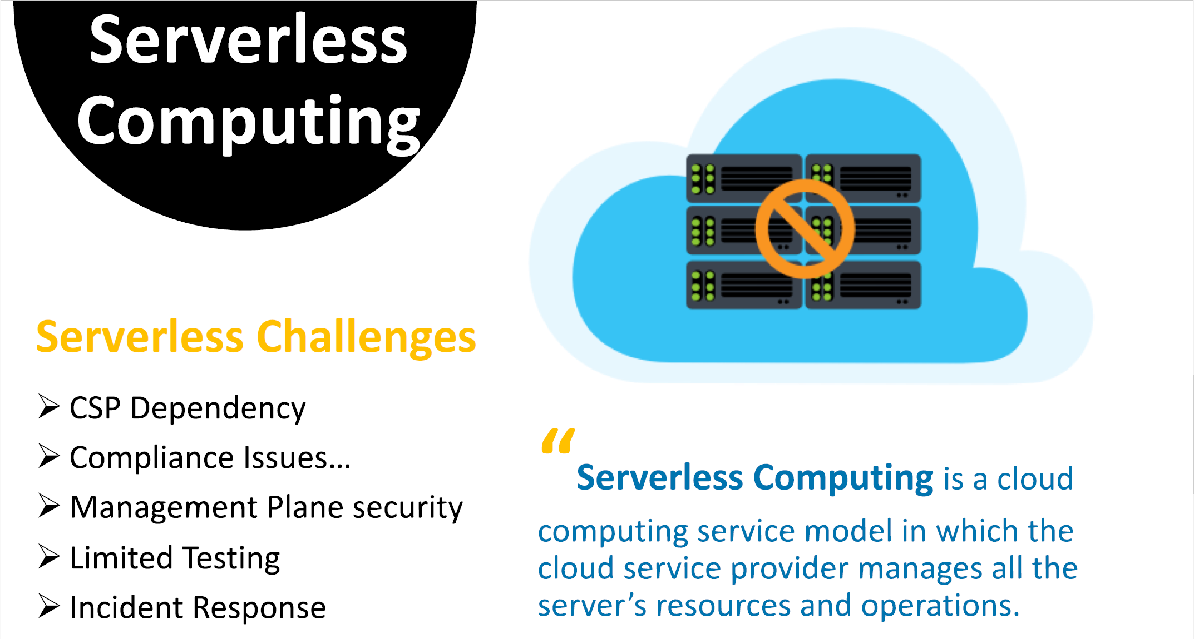
Notes:
CSP: Cloud Service Provider

Slide 47
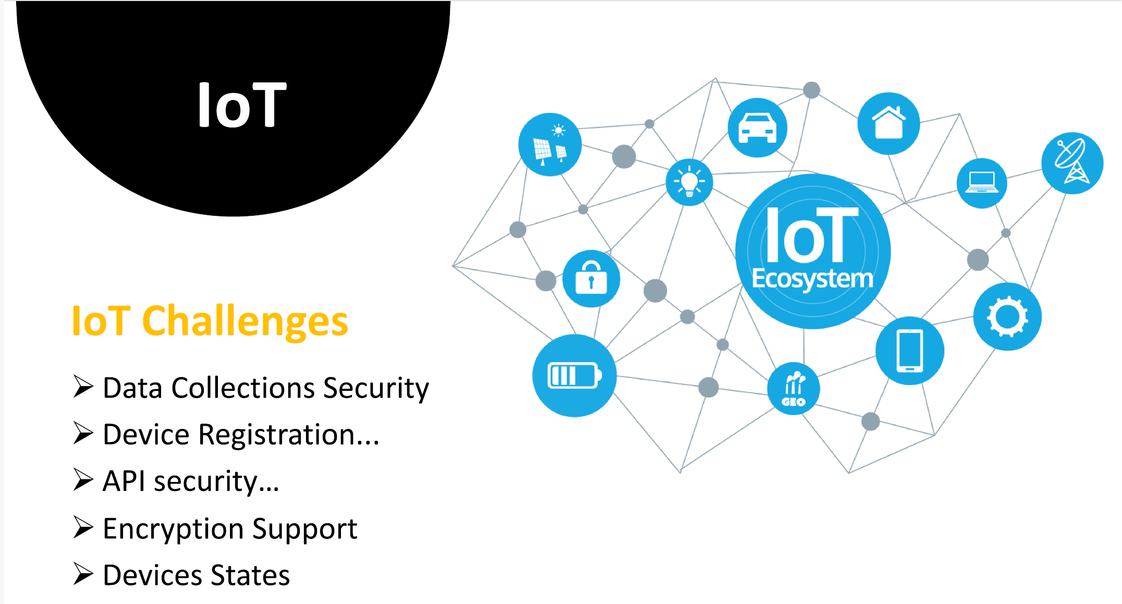

Slide 48
Introduction – what is IoT?
The Internet of things (IoT) is a system of interrelated computing devices, mechanical and digital machines, objects, animals or people that are provided with unique identifiers ( UIDs ) and the ability to transfer data over a network without requiring human-to-human or human-to-computer interaction - IoTAgenda
A thing in the IoT can be a person with a heart monitor implant, a farm animal with a biochip transponder, an automobile that has built-in sensors to alert the driver when tire pressure is low or any other natural or man-made object that can be assigned an IP address and is able to transfer data over a network.
IoT is a sensor network of billions of smart devices that connect people, systems and other applications to collect and share data.

Slide 49
Introduction – cont’d
IoT is a concept of connecting any device with an on and off switch to the Internet (and/or to each other). This includes everything from cellphones, coffee makers, washing machines, headphones, lamps, wearable devices and almost anything else you can think of. This also applies to components of machines, for example a jet engine of an airplane or the drill of an oil rig – Forbes.
The IoT is a giant network of connected "things" (which also includes people). The relationship will be between people-people, people-things, and things-things.
The dominant consumer IoT device, worldwide, is the smart TV. Between 25-35% cent of consumers worldwide own a television that can connect to the Internet, according to a Deloitte research. However, other areas of the IoT market are growing rapidly.

Slide 50
Benefits of IoT
IoT offers a number of benefits to organizations, enabling them to:
Monitor their overall business processes;
Improve the customer experience;
Save time and money;
Enhance employee productivity;
Integrate and adapt business models;
Make better business decisions; and
Generate more revenue.

Slide 51
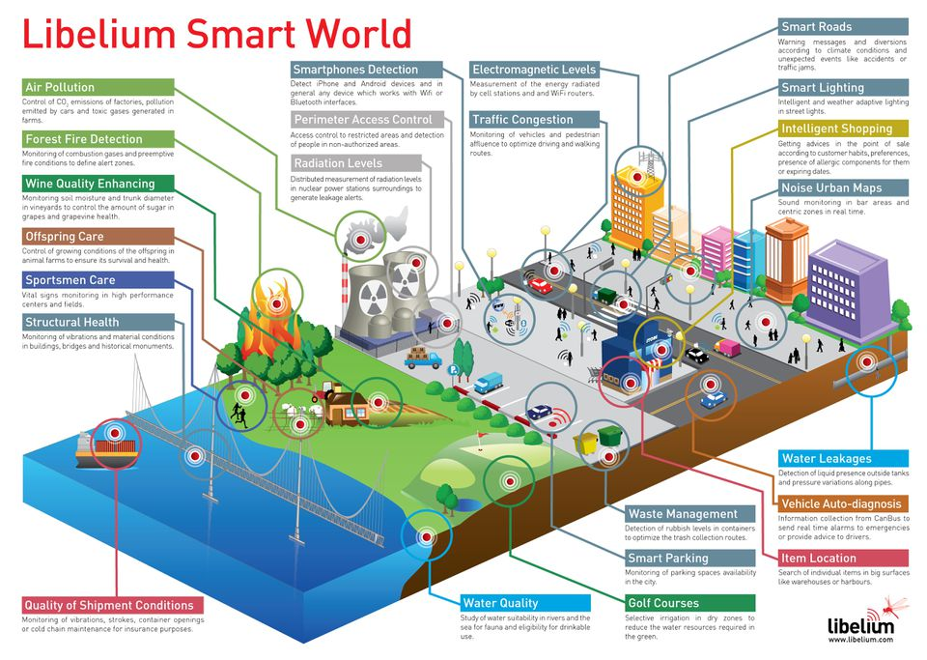
The smart world of the future – using Iot
Source: https://www.forbes.com/sites/jacobmorgan/2014/05/13/simple-explanation-internet-things-that-anyone-can-understand/#ef2433f1d091

Slide 52
Smart farming: Use of iot to improve agriculture
In IoT-based smart farming, a system is built for monitoring the crop field with the help of sensors (light, humidity, temperature, soil moisture, etc.) and automating the irrigation system. The farmers can monitor the field conditions from anywhere. This is highly efficient compared to the traditional/conventional approach.
In terms of environmental issues, IoT-based smart farming provides great benefits including: better and efficient water usage, and optimization of inputs and treatments.
Therefore, smart farming based on IoT technologies enables growers and farmers to reduce waste and enhance productivity.
Some of the IoT applications in this area are:
Precision farming
Agricultural drones
Livestock monitoring
Smart greenhouses

Slide 53
Industrial Iot (iiot)
Industrial IoT (IIoT) focusses on the use of cyber-physical systems to monitor the physical factory processes and make data-based automated decisions.
While the physical systems are made the intelligent using IoT, the real-time communication, and cooperation both with each other and with humans is established via the wireless web
IIoT brings in the concept of ‘a connected factory leads to a smart factory’.

Slide 54
Iiot in manufacturing
Digital/connected factory: IoT enabled machinery can transmit operational information to the partners like original equipment manufacturers and to field engineers.
Facility management: The use of IoT sensors in manufacturing equipment enables condition-based maintenance alerts.
Production flow monitoring: IoT in manufacturing can enable the monitoring of production lines starting from the refining process down to the packaging of final products.
Inventory management: IoT applications permit the monitoring of events across a supply chain.

Slide 55
Iiot in manufacturing (cont’d)
Plant Safety and Security: IoT combined big data analysis can improve the overall workers’ safety and security in the plant. .
Quality control: IoT sensors collect aggregate product data and other third-party syndicated data from various stages of a product cycle.
Packaging Optimization: By using IoT sensors in products and/or packaging, manufacturers can gain insights into the usage patterns and handling of product from multiple customers.
Logistics and Supply Chain Optimization: The Industrial IoT (IIoT) can provide access to real-time supply chain information by tracking materials, equipment, and products as they move through the supply chain.

Slide 56
IOT CHALLENGES
Security, privacy and data sharing issues
Because IoT devices are closely connected, all a hacker has to do is exploit one vulnerability to manipulate all the data, rendering it unusable. And manufacturers that don't update their devices regularly -- or at all -- leave them vulnerable to cybercriminals.
However, hackers aren't the only threat to the internet of things; privacy is another major concern for IoT users. For instance, companies that make and distribute consumer IoT devices could use those devices to obtain and sell users' personal data.
Challenges with IIoT:
Security of data – same as above
Reliability and stability – of IIoT sensors
Connectivity of all the systems in IIoT setup – no maintenance envisioned?
Blending legacy systems – IIoT is new in the market

Slide 57
Introduction to Cloud Computing
Security on Cloud Services
Cloud Storage Security
Cloud Application Security and Access Control
Introduction to Internet of Things
IoT Security and Cloud
Module 5 – Cloud and IoT Security

Slide 58
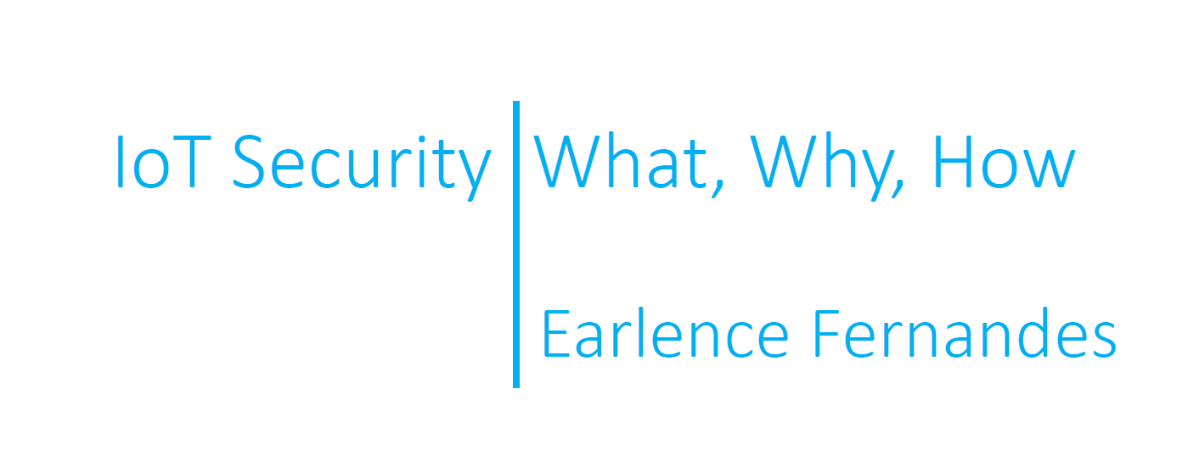
Famous Talk

